Slide 1

OOP Project: Music Maker
Luke Whaley/DJ Whale

Slide 2
My project is a music making program that allows people to create their own songs. The user can set the BPM (beats per minute) of the song, create multiple instruments, and place notes within these different instruments. The user can also save and load their songs.
What is My Project?

Slide 3

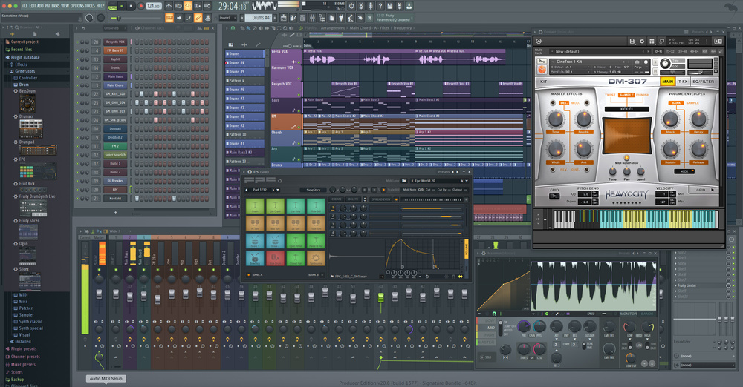
Why I Chose to Make This Project:
I wanted to build this project because in my free time, I make my own music using a program called FL Studio. However, this program may be difficult for new users to learn. I wanted to create a simple and easy to use program that would help people learn the basics of music creation and inspire them to make songs of their own.

Slide 4
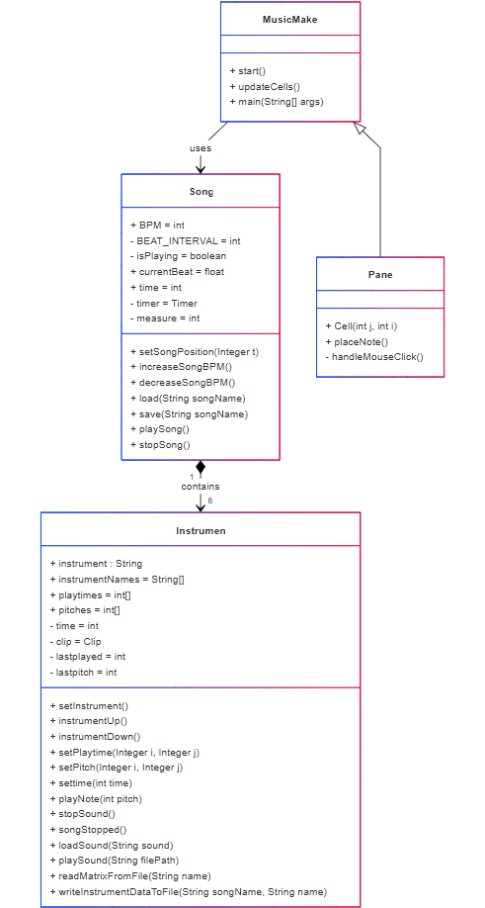
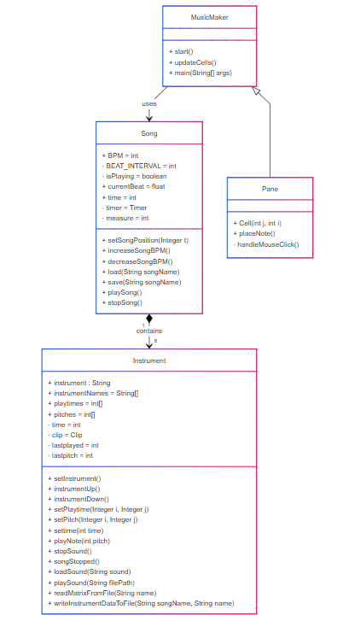
Class Diagram:
r
This class diagram shows the relationship between the different classes in my project.
The Music Maker class uses the song class to play and stop the song. It also includes the Pane subclass, which is used for the note placing UI.
The song class contains 8 instruments, each which have arrays that contain the placement and pitch of individual notes.
I used arrays to contain this data so the information could easily be written to and read from .txt files.
t

Slide 5
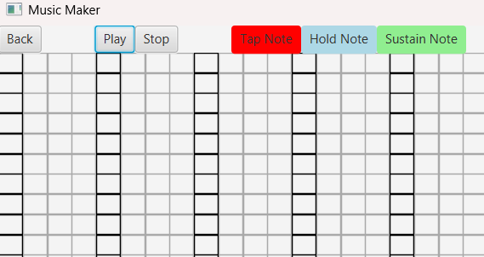
Music Maker Class:
The music maker class handles the UI elements of my project. It has two different scenes, a scene for viewing the overall song, and a scene for placing notes within an instrument.
The music maker class contains the Pane inner class. A grid of Panes is used to create the note placement grid. Event Handlers are used to edit an instrument’s note data when each pane is clicked.
Note Placement Grid:

Slide 6
Song Class:
The Song class contains 8 different instruments that make up the song as well as a variable that determines the song’s BPM (beats per minute). This class also manages the current position in the song.
This class has functions that start and stop the song. When the play button is clicked, the Song class starts a timer to determine when to play the notes of the song. When the timer finishes, which occurs every 1/4th of a beat, each instrument checks to see what notes should be played at the current point in the song. When the stop function is called, the timer is canceled, and the song position variable (time) is set to 0.
This class also manages saving and loading. When the song is saved, a new folder is created with the song’s name that was typed into the text field. The song’s BPM is saved to the “songdata.txt” file within that folder. Additionally, this class calls each instrument to save their note data to separate .txt files within the same folder. When a song is loaded, the note data and BPM are read from these text files.

Slide 7
Instrument Class:
The instrument class loads .wav files in order to play sounds. This is done by using AudioInputStream and AudioSystem.
Each instrument contains two integer arrays: playtimes and pitches. The playtimes array determines if a note is played on a given beat as well as what type of note is played (0 for no note, 1 for tap a note, 2 for hold a note, and 3 for a sustain note).
The pitches array determines what pitch each note is, ranging two octaves (24 possible pitches). The folders that contain each instrument’s sounds contain 24 different .wav files numbered from 1 to 24, each with a different note pitch. What pitch is played at each note is determined by the number that is contained within the pitches array at the current section of the song.

Slide 8
When making this project, I learned many new coding techniques, such as:
What I Learned by Making This Project:
1. How to load and play sounds in Java. 2. How to create timers in Java. 3. How to implement multiple scenes using JavaFX. 4. How to create folders with code and use file paths to locate specific files within them.

